Slide 1
GRADUATION PROJECT PRESENTATION
Presented By:
Hassan Mohamed Hassan
Kareem Atef Mohamed Mohamed
Mohamed Elsayed El Talawy
Hader Ali Ibrahim El Gendy
Ahmed Khaled Omran Mohamed
Mohamed Tarek Baset
Track: Odoo Application Consultant Instructor Name: Diaa Hamdan

Slide 2
Introduction
Odoo 17's Sales module is a powerful tool for managing sales processes, from quote ▶
creation to invoicing. It offers features like client management, sales team organization, and subscription management, streamlining workflow and improving efficiency. Odoo 17's fast processing speed and continuous updates ensure optimal performance.
The product is obviously a crucial element in any type of business. No matter if it is a consumable product or a service product.

Slide 3
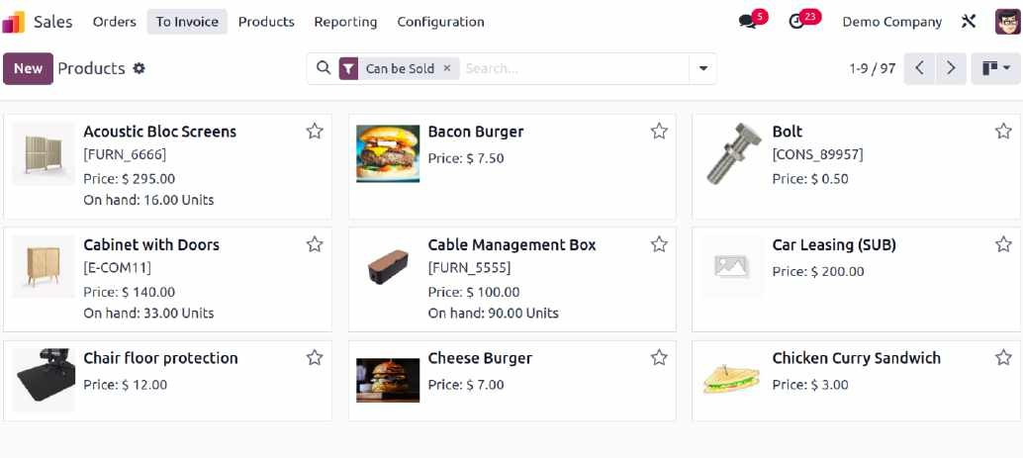
Odoo provides a specific platform for keeping track of all pertinent information about product management and to ensure that important data about the products that are set up in the system for sales operations is tracked. You can find relevant tabs to record accounting, purchasing, inventory, eCommerce, and many other types of data linked to product management operations in each product configuration window.
The product management window's Kanban view is shown in the screenshot that follows.

Slide 4
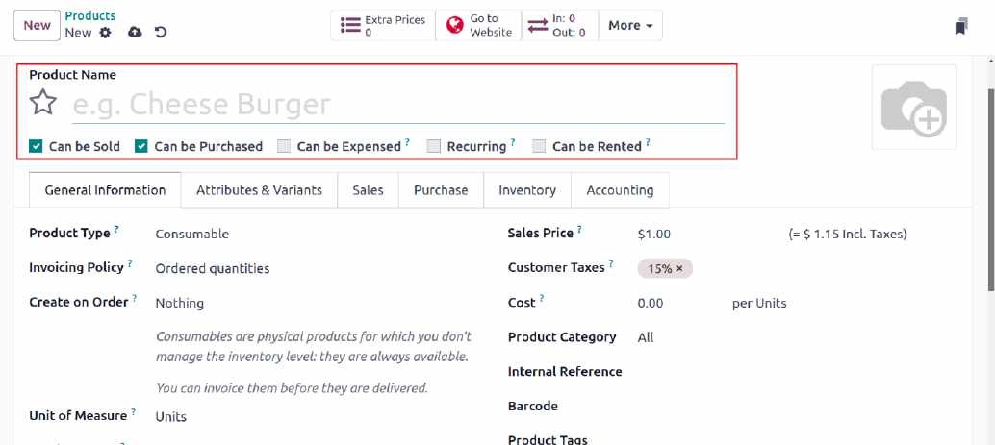
In the Product Name column, the product's name may be mentioned. If you want to sell this product, you can select the Can be Sold option. This product can be set up to be purchased by using the Can be Purchased option. By using the Can be Expensed option, the product can be chosen at a cost. By choosing the Recurring option while confirming a sales order for this product, a subscription will be created. By selecting the Can be Rented option in Odoo , you can rent the item.

Slide 5
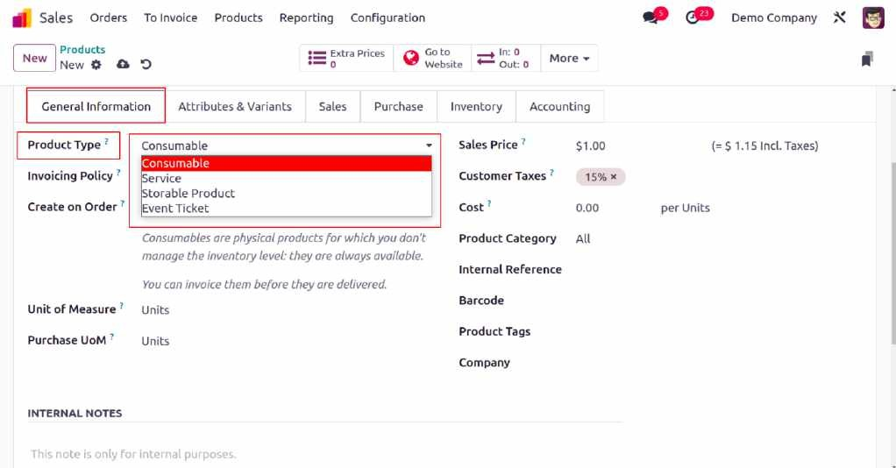
The general information about the product is mentioned on the General Information tab
Odoo product types include Consumable, Service, Storable Products, Event Tickets, Courses, and Event Booths. Odoo invoicing policies can be set for each product type. You can invoice based on ordered quantities or delivered quantities

Slide 6
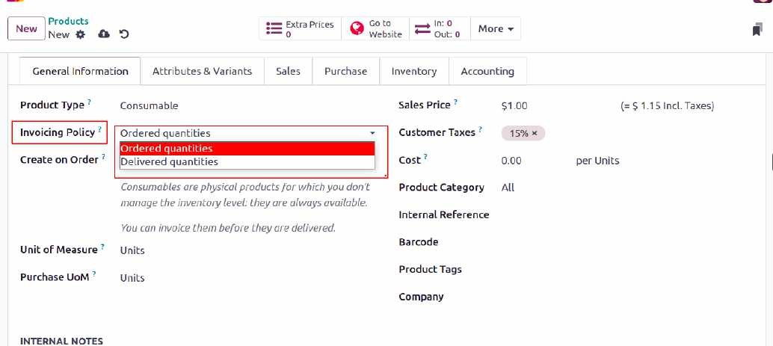
In the Unit of Measure section, set a default UoM for stock activities and specify a Purchase UoM, which must match the standard UoM class. You can also enter details like Cost, Product Category, Internal Reference, Barcode, Product Tags, and Company information.

Slide 7
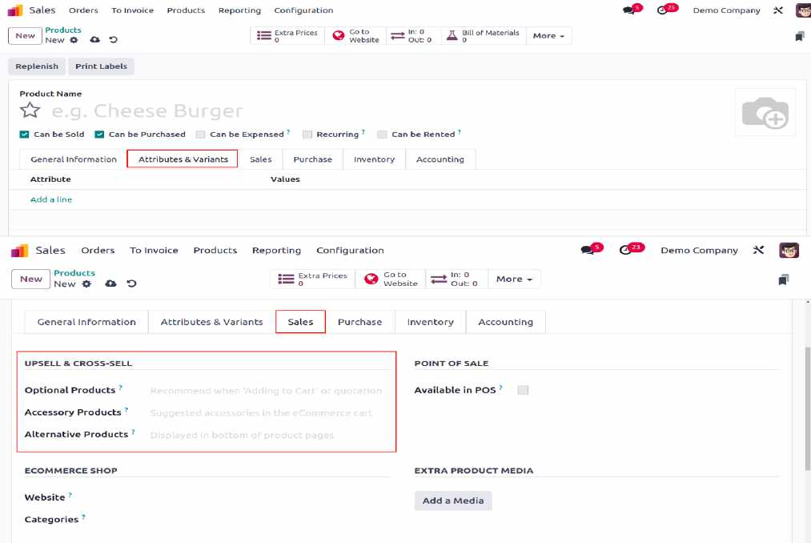
Under the Attributes & Variants tab, list product variations. In the Sales tab, set up sales info, point of sale, eCommerce, and upselling/cross-selling options like Optional, Accessory, and Alternative Products.

Slide 8
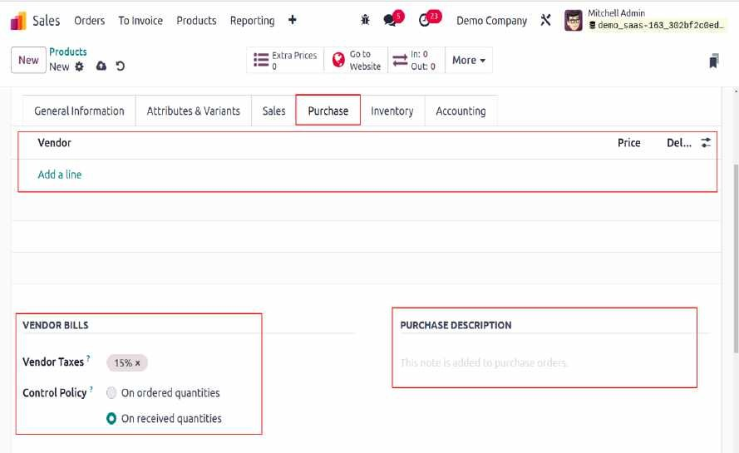
The Purchase tab can be used to define the purchase-related details when configuring a product that can be purchased.

Slide 9
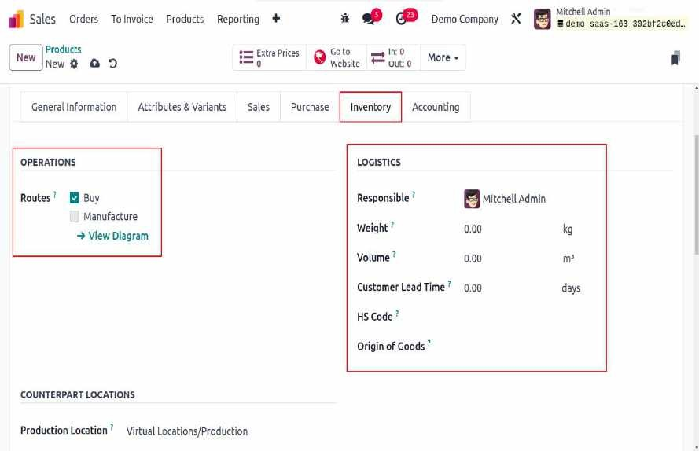
In the Inventory tab, manage product inventory and select operation routes based on installed modules. Assign a responsible user for logistics, and specify the product's weight and volume.

Slide 10
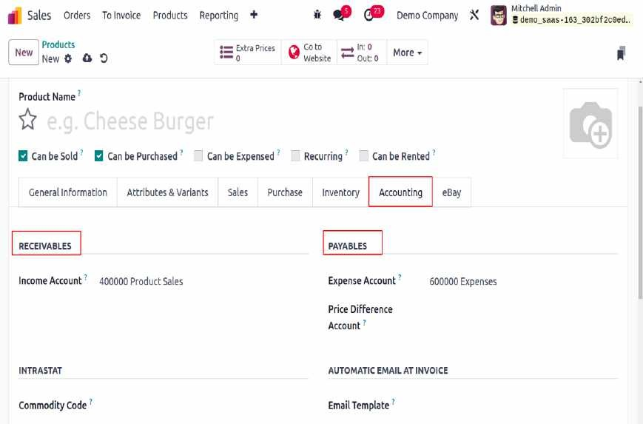
The Accounting tab tracks financial info. Specify the Income Account in Receivables and the Expense Account in Payables. Price differences between purchase orders and vendor bills are recorded in the Price Difference Account for automatic inventory valuation.

Slide 11
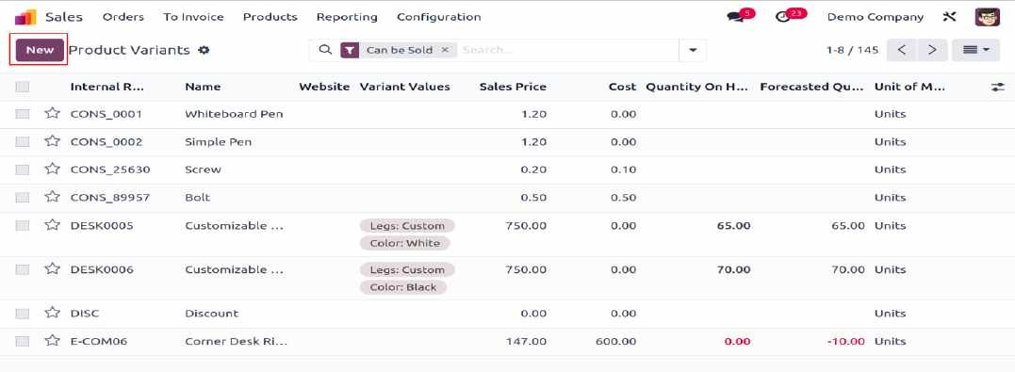
In Odoo 17, enable product variants in the Sales module from the Settings menu under the Product Catalog tab. Once activated, you can use attributes to offer different versions of a product. Use the Product Variants option under the Products menu to configure new product versions .
A list of already configured Product variants is available. You can quickly add a new one by using the
NEW button.

Slide 12
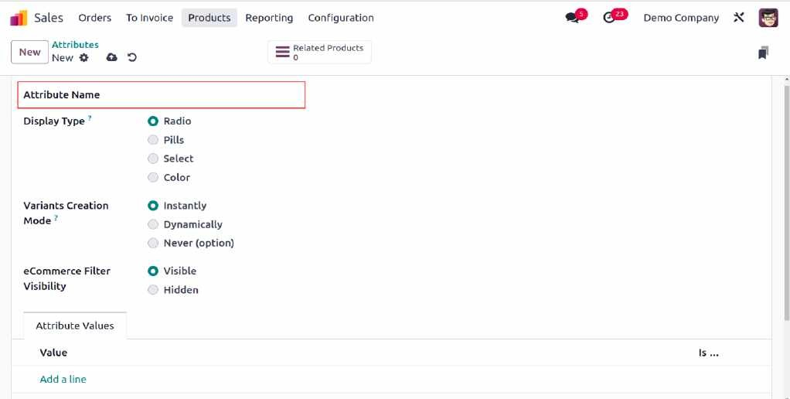
Customize product attributes to define versions by selecting the **Attributes** option from the
**Configuration** menu. You can enter the name of the attribute in the Attribute Name field. Create a category to group comparable attributes into one area on the eCommerce comparison page.

Slide 13
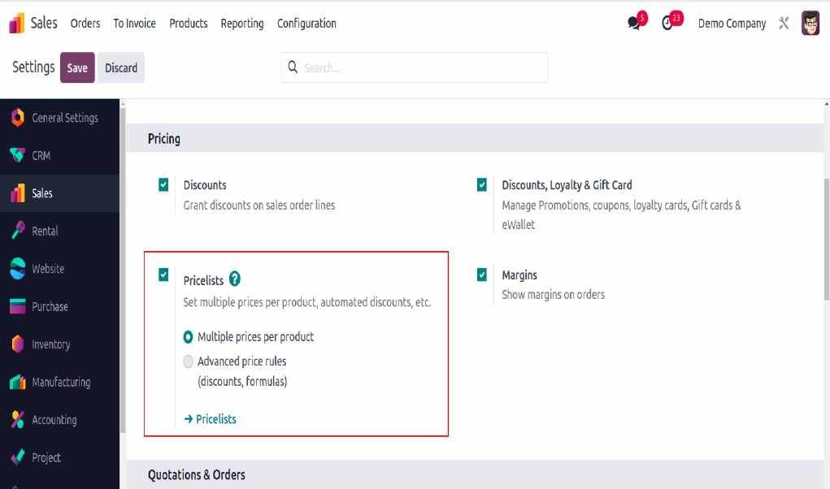
Odoo 17 offers advanced pricing options for your company's strategy, allowing you to create tailored price lists for specific clients. To set up new price lists in the Sales module, simply activate the Price Lists feature in the Pricing tab under the Settings menu.

Slide 14
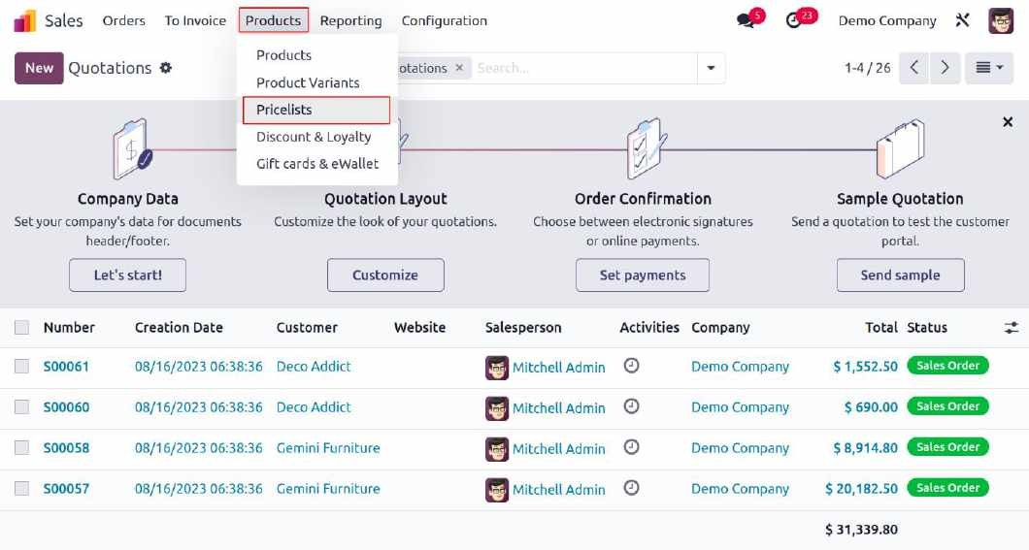
In Odoo 17, users can create two types of price lists:
Multiple Prices per Product .
Advanced Price Rules (discounts, formulas) .
After enabling the Pricelist feature, access it via the Products menu.

Slide 15
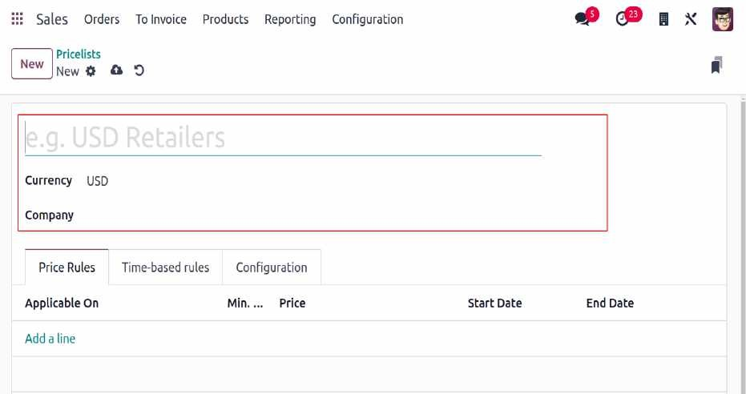
Advanced Price Rules
To create an advanced price list in Odoo 17, enable the Pricelist feature from the Settings menu. Then, access the Pricelist option under the Products menu and click "New." In the setup window, you can name the price list, select the currency, and enter your company name. The setup window includes three tabs for additional price list details.

Slide 16
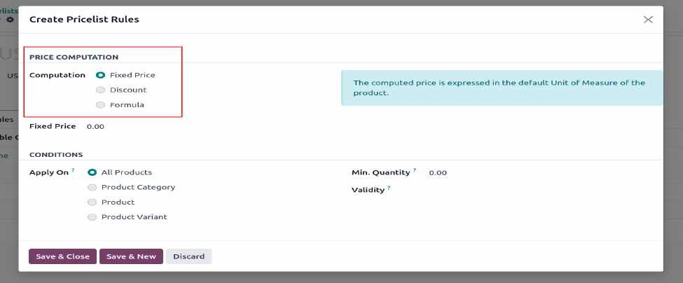
Using the "Add a Line" option in the Price Rules menu, you can create new price rules for products. Select from three price computation methods: Fixed Price, Discount, or Formula. Based on your selection, additional fields will appear for further details.
For example, selecting Fixed Price will prompt you to enter the price. You can apply the rule to All Products, a Product Category, a specific Product, or a Product Variant using the "Apply On" field.

Slide 17
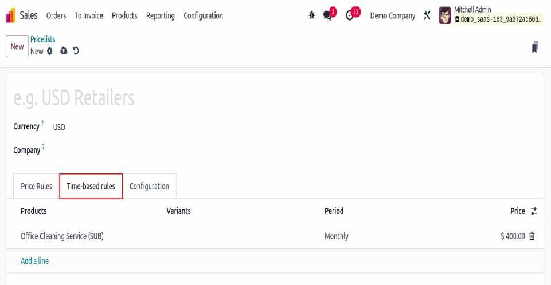
In the Time-based rules tab, you can set recurring price rules by clicking "Add a Line" to select the product and its variants. Use the Period box to set the minimum time before the rule applies, and choose the time unit (hours, days, weeks, months, or years). Once a product is selected, the price will automatically appear in the designated field.

Slide 18
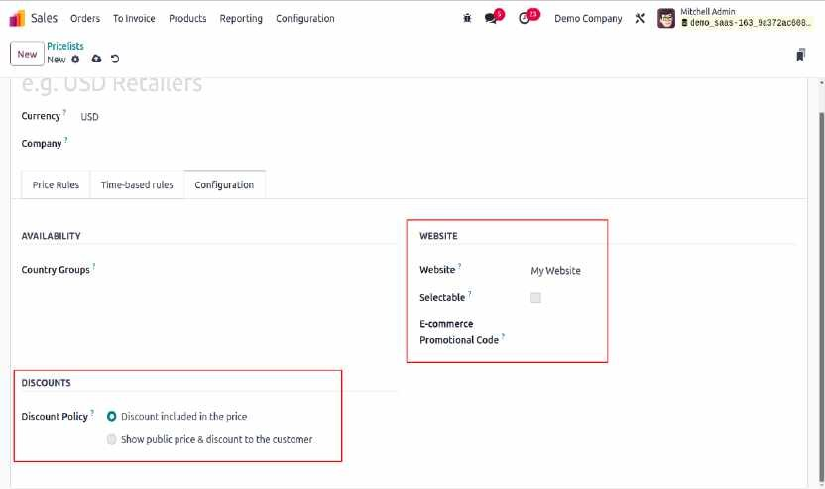
In the Configuration tab, you can set the Availability for specific Country Groups and choose the Discount Policy: either "Discount included in the price" or "Show public price & discount to the customer."

Slide 19
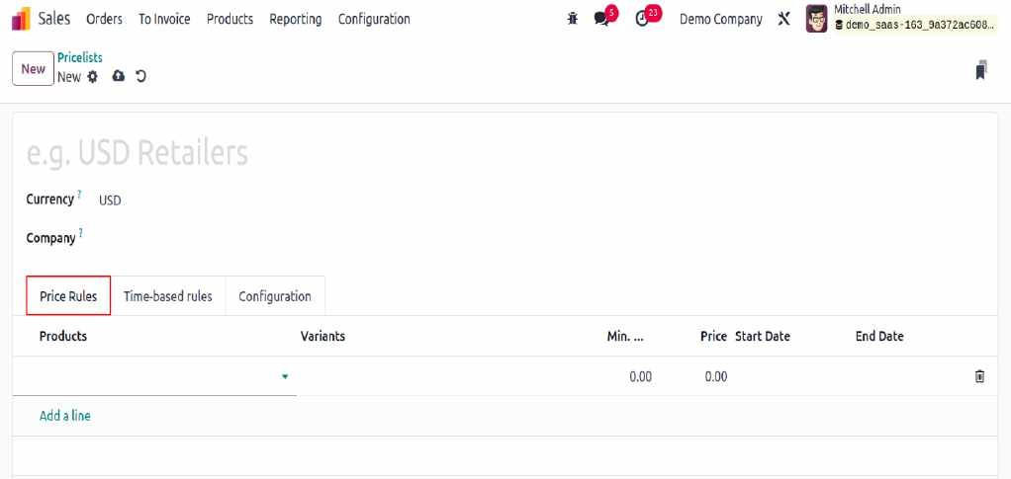
Multiple Prices per Product:
To create different prices for a product, enable the "Multiple Prices per Product" option in the Pricelist settings. The setup is similar to advanced price rules, but in this case, use the "Add a Line" button in the Price Rule tab to add products to the price list.

Slide 20
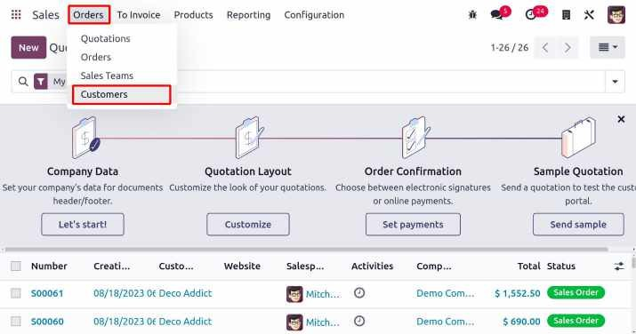
Customers
In Odoo 17, you can manage customer records through the Customers platform, located under the Orders menu in the Sales module.

Slide 21
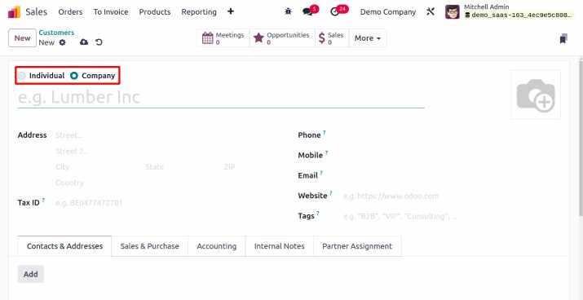
Click the "New" button to create a customer profile by entering the person's or business's name. You can then add details such as address, tax ID, phone, email, website, language, and tags.

Slide 22
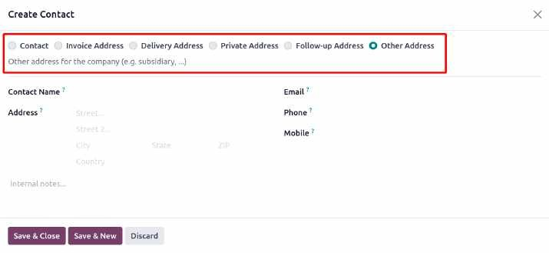
In the "Contacts & Addresses" tab, click "Add" to specify the contact type, such as Invoice, Delivery, Private, Other, or Follow Up Address. Then, enter the contact's details like name, address, email, phone, and mobile number.

Slide 23
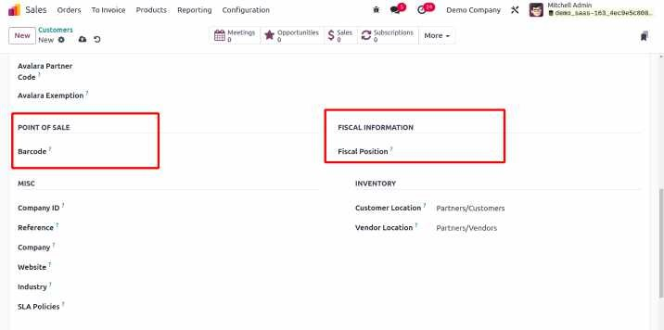
Under the Sales & Purchase tab, you can configure details for sales and purchase operations with the customer. Assign a Salesperson and Sales Team, set a specific Payment Period for invoices, and provide a unique Price List. Enter the Avalara Code, Partner Code, and Exemption. You can also specify the default Delivery Method for sales orders.
In the Purchase tab, select preferred Payment Terms for vendor bills. Specify the preferred Payment Mode and enable receipt reminders for confirming receipt dates. The Supplier Currency will be used for purchases from the current partner.

Slide 24
For identification at the point of sale, you can assign a Barcode and specify the Fiscal Position under Fiscal Information. Additional details like Company ID, Reference, and Customer Location can be entered under the Miscellaneous tab. The Vendor Location allows you to choose where to receive products from this contact.

Slide 25
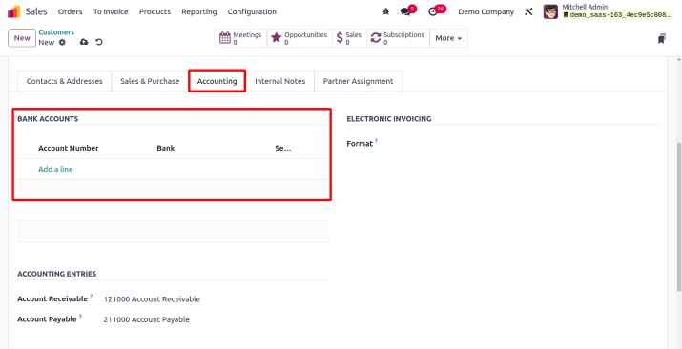
Under the Accounting tab, you can define the customer's accounting information. Use the "Add a Line" button to list the customer's bank accounts and account numbers. Specify the Account Receivable and Account Payable under the Accounting Entries field.

Slide 26
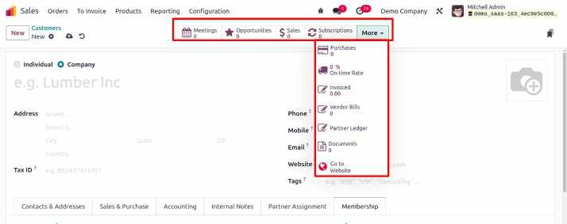
The Associate Member box allows you to link a member to the customer's membership and displays their current membership status. You can purchase a membership using the "Buy Membership" button, which shows details like Join Date, Membership, Price, Invoice, and Status.
Smart buttons provide quick access to operations related to the customer, such as meetings, opportunities, sales, subscriptions, tasks, purchases, invoiced amounts, vendor bills, partner ledger, payment tokens, certifications, documents, direct debit requirements, and course information.

Slide 27
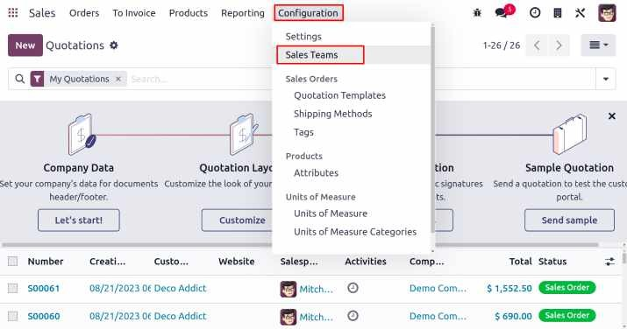
Sales Team
An effective sales team is crucial for managing all sales operations within a company. The Odoo 17 Sales module allows you to create multiple teams to enhance sales efforts. The CRM module also offers configuration options for sales staff. Access the platform to build and manage sales teams by selecting the Sales Teams option under the Configuration menu in the Sales module.

Slide 28
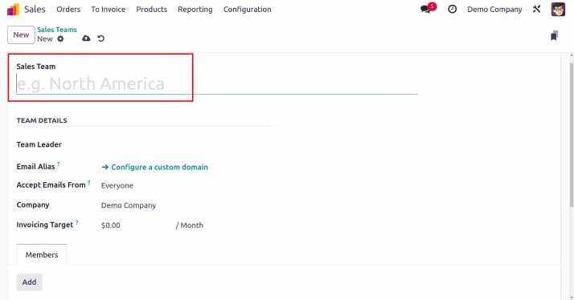
In the new sales team configuration window, enter a team name in the Sales Team section. To provide quotations instead of confirming sales orders, check the Quotations box. Tick the Pipeline box to manage pre-sales opportunities, and check the Leads box to filter incoming inquiries as leads.
Designate a Team Leader in the "Team Details" section and configure a custom email alias. In the Accept Emails From section, choose from Everyone, Authenticated Partners, Followers only, or Authenticated Employees. Specify the associated Company and set a monthly revenue target in the
invoicing target box

Slide 29
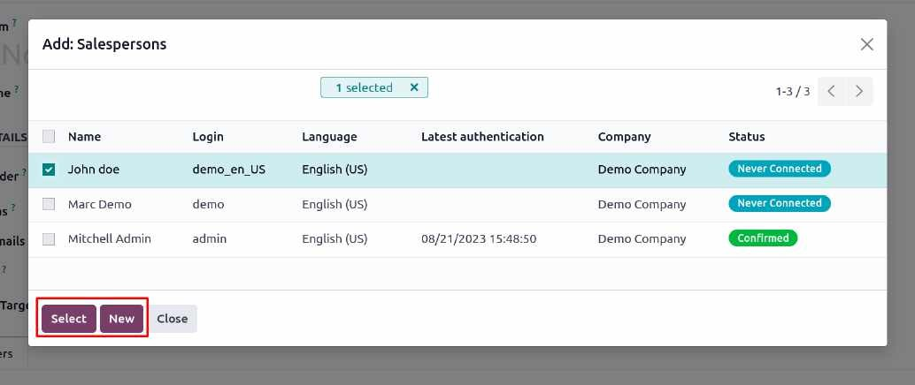
To add team members, click the Add button under the Members tab. A new wizard will appear, allowing you to select team members. Once you add the desired members, the new sales team will be saved in your system.

Slide 30
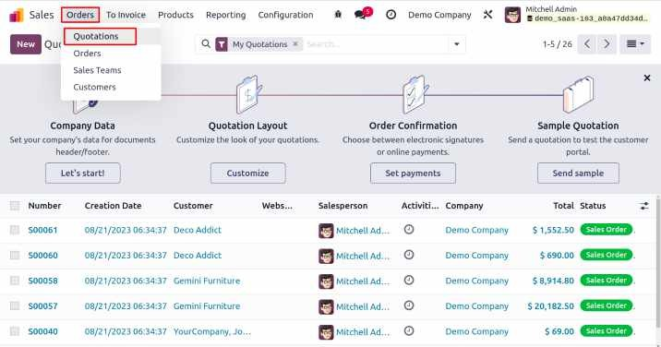
Sales Quotations
Sales quotations are the starting point for creating sales orders, serving as a contract between the vendor and buyer that outlines the relevant details and pricing of goods. Odoo 17 allows you to easily generate and send quotations to customers, providing them with accurate pricing information before finalizing any sales agreements. If the customer approves the offer, the sales quotation can be converted into a sales order.
You can create and manage quotations under the Orders menu in the Sales module, where you can also access existing sales quotations.

Slide 31
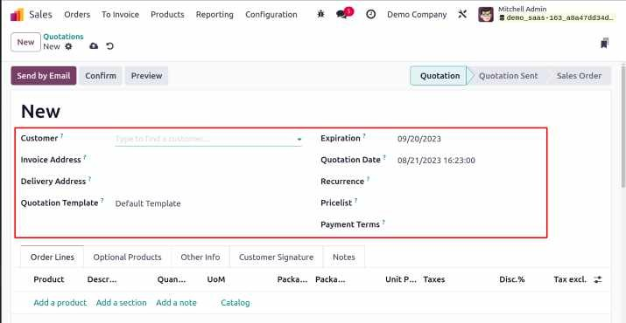
To create a new sales quotation, select the customer's name from the list. The Invoice Address, Delivery Address, pricelist, and Payment Terms will automatically populate based on the customer's information. Also, include the Referrer, Quotation Template, and Expiration Date. The Quotation Date field will display the creation date.

Slide 32
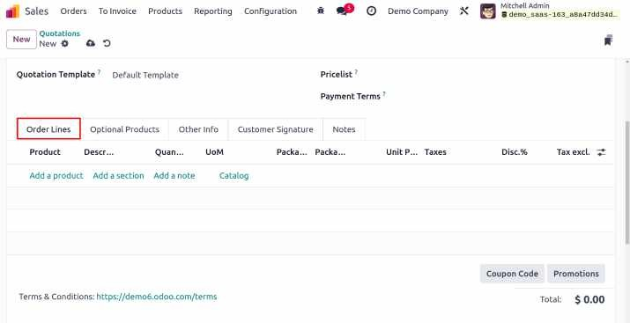
Under the Order Line, you can add products for the customer using the "Add a Line" button. Enter the Product, Description, Quantity, UoM, Unit Price, Taxes, Discount, and Subtotal. You can add as many products as needed.

Slide 33
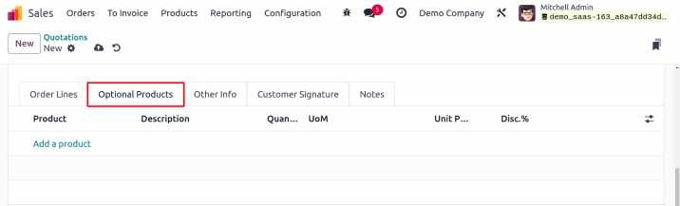
Businesses may provide customers with additional products as a part of their cross-selling techniques. In such circumstances, the Optional Products section is where you would mention those other products.

Slide 34
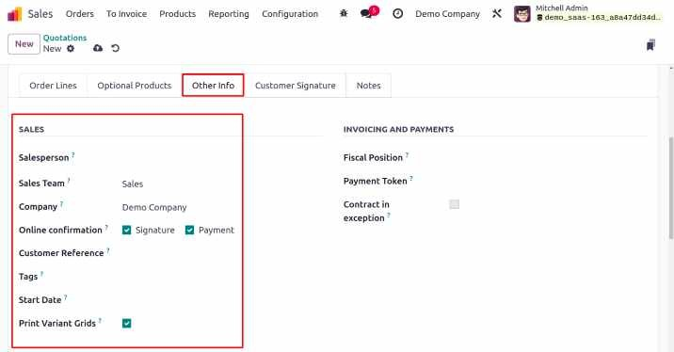
In the Sales section, designate a Salesperson to manage the quotation. Sales Team and Company names will auto-populate. Enable Online Signature for online customer signing and Online Payment for payment options. Add Customer Reference and Tags to print variant grids and reference Fiscal Position for tax adjustments. Specify Analytic Account, Account Tags, and Payment Token, and activate Contract in Exception if needed.

Slide 35
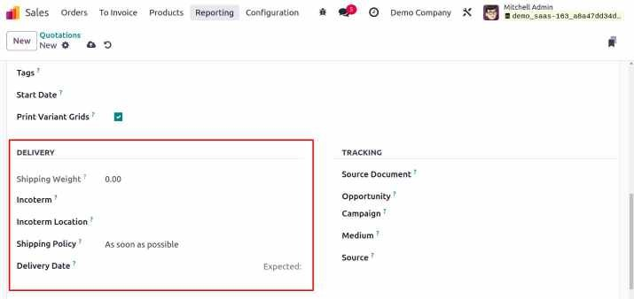
Choose a Shipping Policy (as soon as possible or when all products are ready) and mention the delivery date in the Delivery Date column. In the Tracking section, fill in the Source Document, Opportunity, Campaign, Medium, and Source for tracking purposes. Activating Online Signature adds a tab for capturing the customer's signature on the quotation

Slide 36
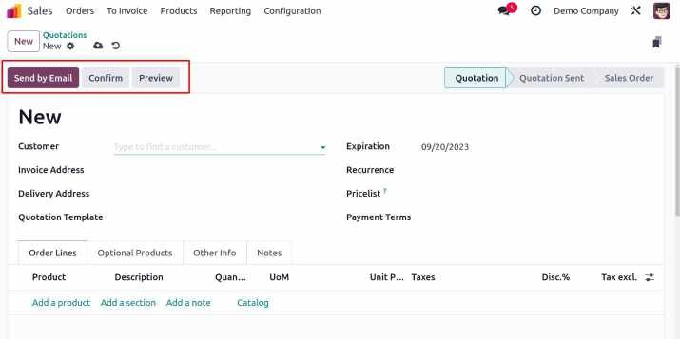
Send the quotation to the client via email using the "Send By Email" option. If the customer approves the quotation, finalize the sale by clicking the Confirm button to convert it into a sales order. You can cancel the quotation using the Cancel button or view the customer preview by clicking the Preview button.

Slide 37
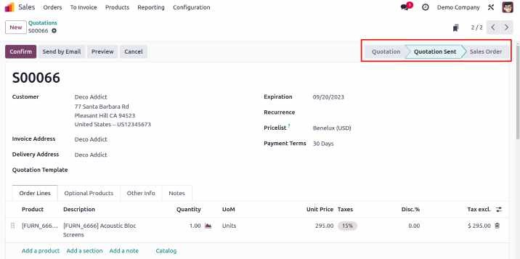
As shown in the figure below, the status of the quotation will be changed to "Quotation Sent."

Slide 38
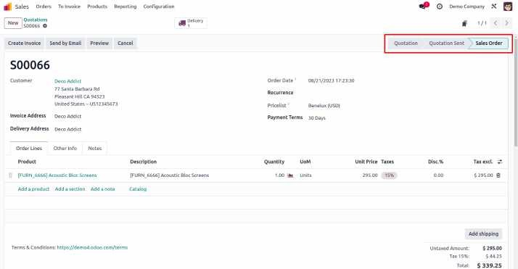
Sale Order
You can now select the Confirm button. The status of the quotation will change to Sales Order after you click the CONFIRM button, as seen in the figure below.

Slide 39
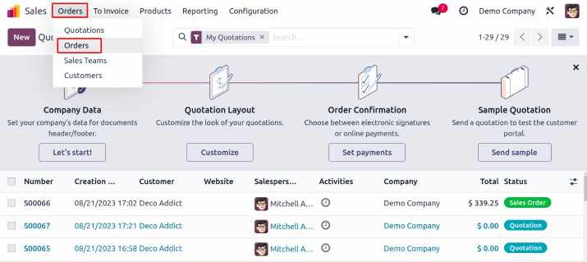
The Sales Order Number, Order Date, Website, Customer, Salesperson, Activities, Company, Total, and Invoice Status are displayed in the platform's list view. Odoo supports List, Kanban, Calendar, Pivot, Graph, and Activity views. Filters and Group By options help streamline search operations with default and customizable choices.

Slide 40
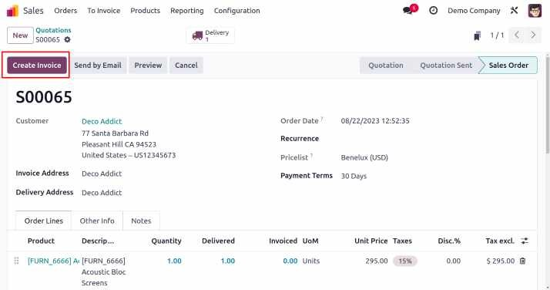
In Odoo 17, creating invoices for sales orders is simple. After confirming a sales order, a "Create Invoice" button appears in the sales window.

Slide 41
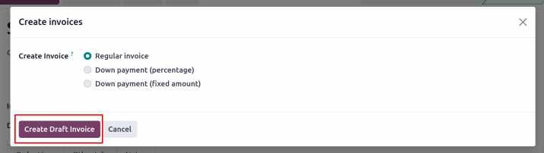
Select "Create Invoice" from the menu. To choose the type of invoice, a popup window will open. Based on your organization's invoicing policies, choose between a Regular Invoice, Down Payment (%), or Down Payment (Fixed amount). Click "Create Draft Invoice" to view the draft in a new window.

Slide 42
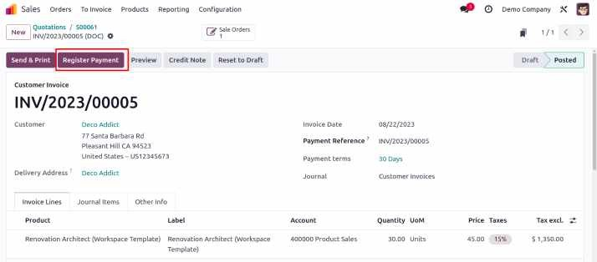
After confirming the invoice, click "Register Payment" in Odoo 17 to process the payment.

Slide 43
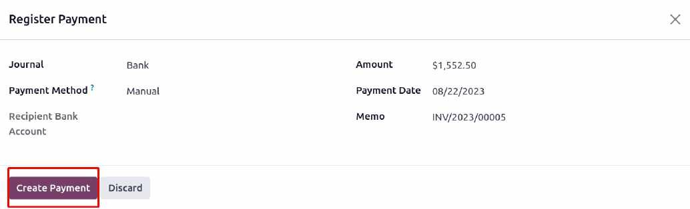
In the new wizard, define the Journal, Payment Bank, Recipient Bank Account, Amount, Payment Date, and Memo. Click "Create Payment." The invoice status will change to "In Payment," and to "Paid" once the customer completes the payment.

Slide 44
The Odoo 17 Sales module includes several advanced options in its Settings menu to enhance functionality. These features can be activated or deactivated based on your specific needs, allowing for a more tailored implementation. Depending on the tasks you perform, you can adjust these settings to optimize sales operations. Let’s explore these options in more detail.

Slide 45
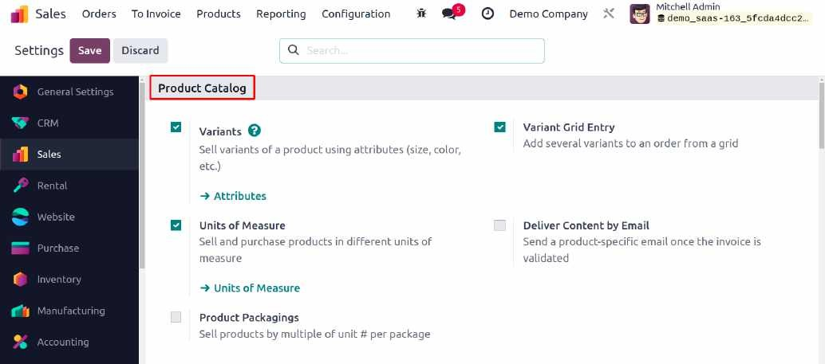
In the Odoo 17 Sales module, you can configure product variants and attributes by enabling the "variants" option from the Product Catalog menu. You can also set multiple units of measure for products by activating the "Units of Measure" option, which is essential for managing sales effectively.

Slide 46
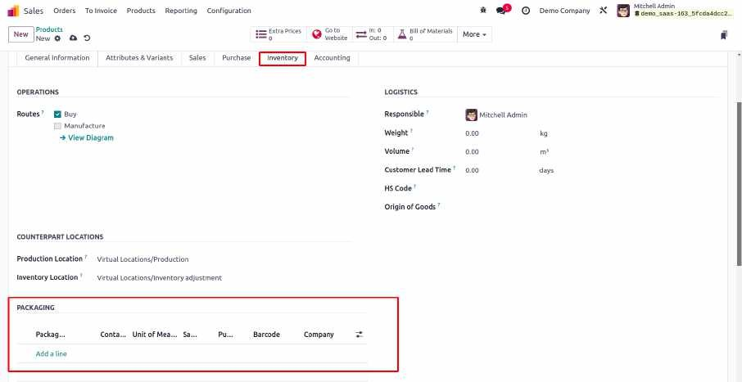
Odoo 17 allows you to manage and sell packaged goods by enabling the "Product Packagings" option. You can specify packaging types in the product settings under the Inventory tab. The Inventory module also helps in managing product bundles efficiently.

Slide 47
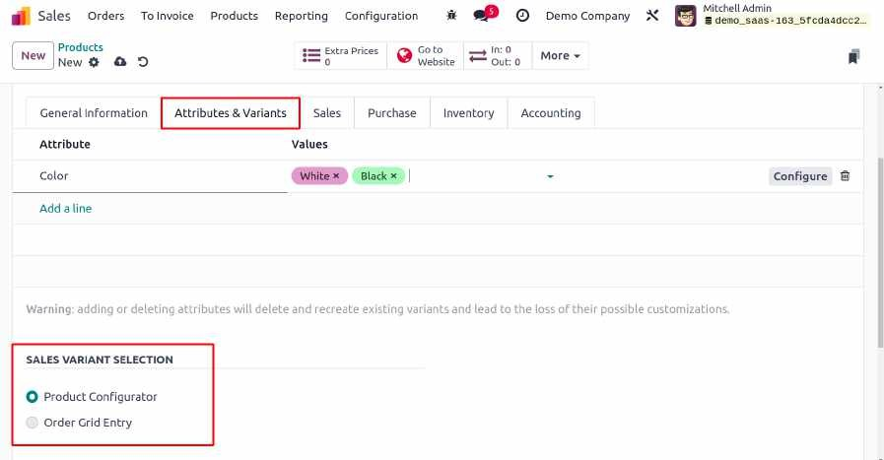
Enable the "Variant Grid Entry" feature to add multiple product variants to a sales order. In the Attributes & Variants tab of the product setup, you can configure variant selection with two options: Product Configurator or Order Grid Entry.
When creating a sales order, a pop-up will appear for selecting product variants.

Slide 48
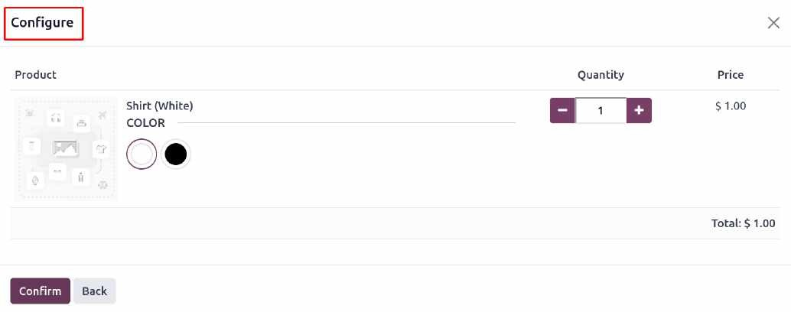
1. Product Configurator

Slide 49
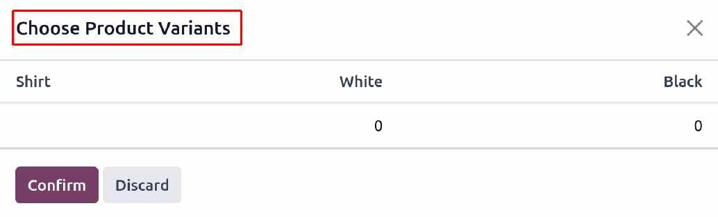
2. Grid Entry

Slide 50
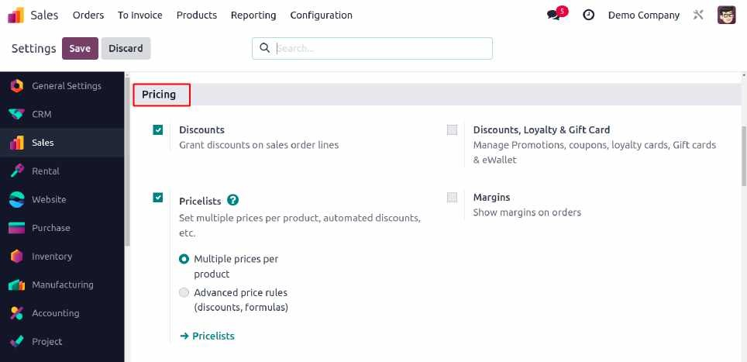
Pricing
The pricing tab in the Settings contains options Discounts, Pricelists, Discounts & Gift Card, and Margin.

Slide 51
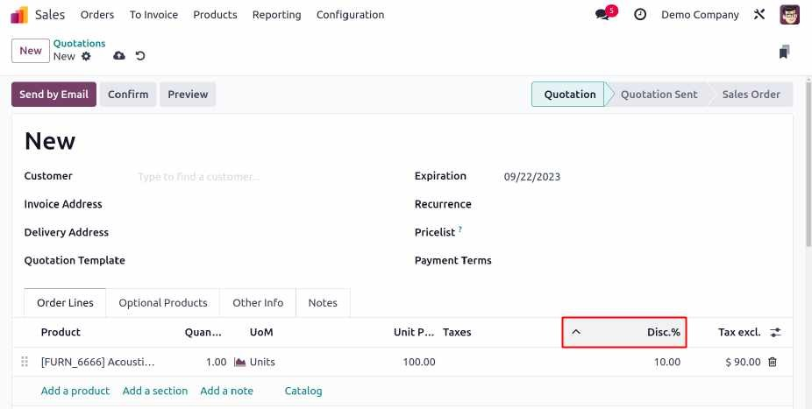
Enable the "Discounts" feature from the Pricing tab in the Settings menu to apply discounts to sales order lines. Discounts can be added manually or automatically based on the applicable price list.

Slide 52
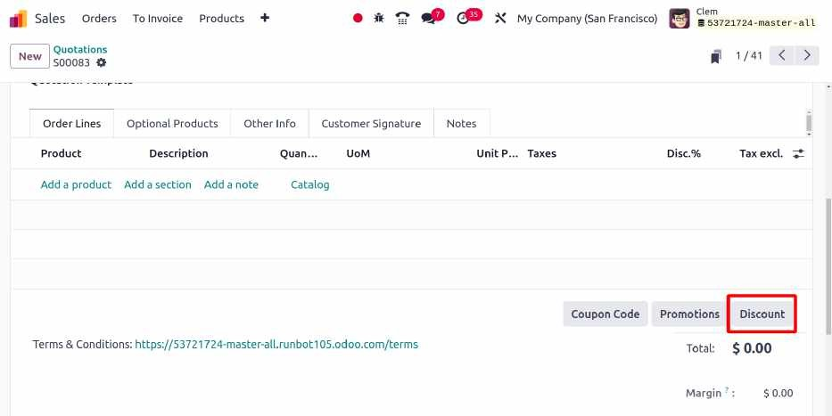
Odoo 17 introduces a new discount option in the order line, accessible after enabling the "Discount" feature. You can select and apply discounts directly from the order line.

Slide 53
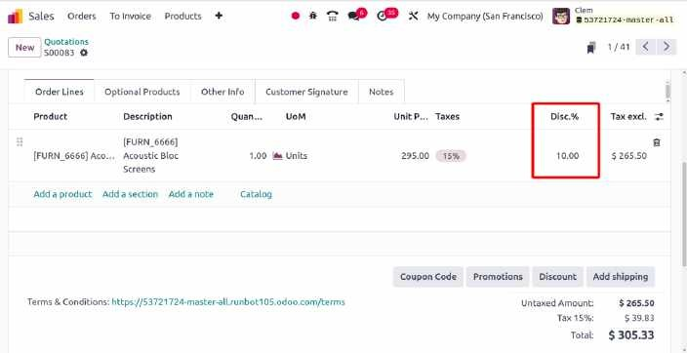
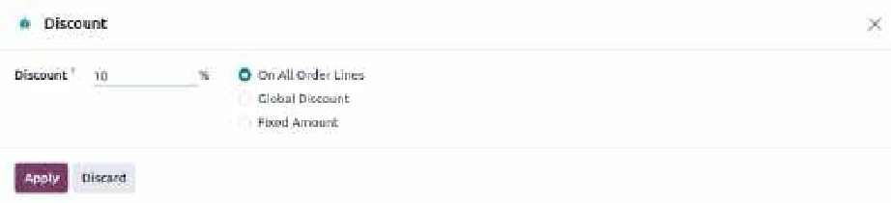
The user can apply a global discount, a fixed discount, or a discount on every order line by using this. Select a single kind and apply the coupon.
The discount will then be added to the order line by clicking the Apply button, as seen in the screenshot below.

Slide 54

Enable the "Margins" feature from the Settings menu to include margins in sales orders or quotes. The margin is calculated by subtracting the product cost from its sales price.

Slide 55

The Quotations & Orders tab includes features like Default Values, Quotation Templates, Online Signature, Online Payment, Sale Warning, Pro-Forma Invoice, and Lock Confirmed Sale.

Slide 56

Invoicing
The Invoicing tab contains Invoicing Policy, Down Payments, Automatic Invoice, and Consolidate subscription billing.

